Slide 1

Introduction to Maya API Programming and Custom UI
Kristine Middlemiss, Autodesk
Developer Consultant, Autodesk Developer Network

Slide 2
Topics
What is an API?
Maya Architecture Overview
Dependency Graph
Command Architecture
Introduction to Maya API
Plug-in Development

Slide 3
What is an API?
Application Programming Interface
It is a contract between the server application exposing the API and the client using that API.
Client
API
MyApp.exe
1. Source code 2. Static library
3. DLL 4. EXE

Slide 4
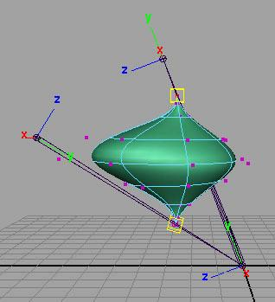
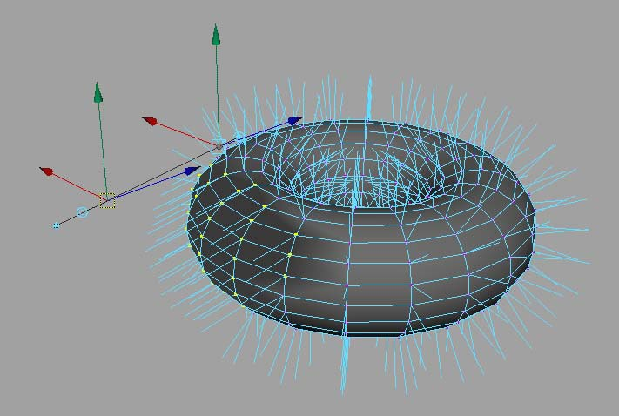
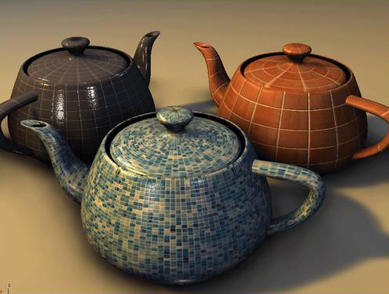

But really, what can you do?
Commands
Dependency Graph Nodes
Deformers
Shaders
Manipulators
Shapes
Etc.
Tools /Contexts
File Translators
Automation

Slide 5
API Design Overview
API is a tight wrapper around Maya’s
internal architecture
An abstract layer, which separates Maya internal code from external plug-in developers
External Developer
Maya API
Maya Core

Slide 6
Maya Architecture Overview

Slide 7
Maya Architecture Overview
Two vital concepts of Maya
architecture:
Dependency Graph
Command Architecture

Slide 8
Dependency Graph

Slide 9
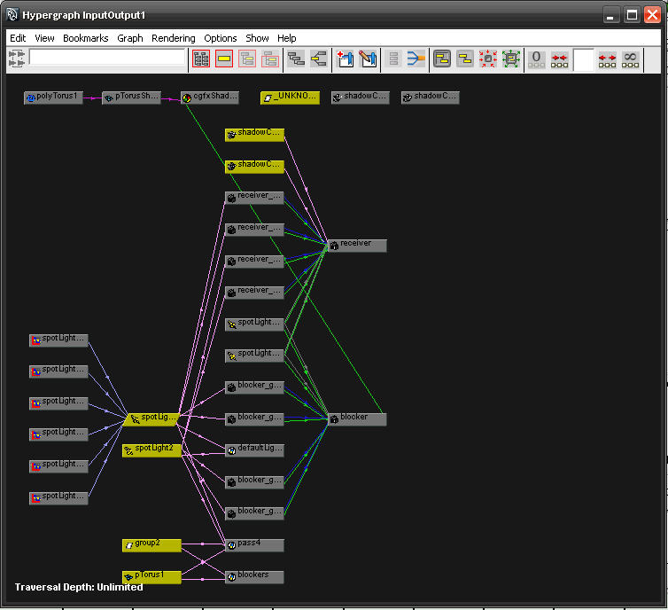
Maya Hypergraph

Slide 10
Dependency Graph
Control system for Maya
Glue that holds together disparate operations and lets them work together seamlessly
Foundation of the Maya file format

Slide 11
Dependency Graph
Notes:
In a complex Maya scene, this is More like what you’ll end up with

Slide 12
Dependency Graph
A collection of nodes that transmit data through connected attributes
A
A.a
B
C
B.b

Slide 13



DAG(Directed Acyclic Graph)
DAG nodes are special dependency graph nodes that form a scene hierarchy (parenting).
Car
seats
frame
tires
Notes:
Where to find DAG node: Hypergraph: - DAG
There is a special type of DG nodes, called “DAG”nodes. Define parent-child relationship

Slide 14
Command Architecture

Slide 15
Maya Command Architecture
Maya GUI
MEL Commands
Maya Core
OS
Notes:
On top of that is MEL commands layer, command engine layer. User can send MEL commands to Maya directly through this layer. This layer talk to Maya core to finish user-specified tasks.

Slide 16
What do we need API for?
New Custom Node
Notes:
How to take advantage of DG design and extend Maya’s functionality

Slide 17
What do we need API for?
Maya UI
Custom MEL Command
MEL Commands
Maya API
Maya Core
OS

Slide 18
Introduction to Maya API

Slide 19
Language of Choice?
Scripting and API
Script languages in Maya
Maya Embedded Language (MEL)
Python scripting
API languages in Maya
C++
Python libraries
2 version of Maya-Python
Converting C++ and MEL types to Python isn’t always easy
Python API wraps C++
Python scripting replicate MEL capabilities

Slide 20
How they fit into Maya
SCRIPTING CHOICES
Overlapping Functionality
API CHOICES
MEL command docs
1. C++ API
1. MEL Scripting
Same class docs
Python command docs
2. Python API
2. Python Scripting
Maya Application
Notes:
Methods not supported in Python:
Marked by: NO SCRIPT SUPPORT
In most cases, alternate forms are provided
Devkit examples translated from C++ to Python
Demonstrate how to map features to Python (devkit/plug-ins/scripted)
Discussed using maya.cmds in Script Editor and modules and maya.OpenMaya* in Python scripted plug-ins separately
Same usage distinctions as C++/MEL
With Python, the line between a "script" and a "plug-in" is blurred
Can access maya.OpenMaya* API classes outside of a scripted plug-in

Slide 21
Maya Libraries
OpenMaya: fundamental classes for defining nodes and commands and for assembling them into a plug-in.
OpenMayaUI: classes necessary for creating new user interface elements such as manipulators, contexts, and locators
OpenMayaAnim: classes for animation, including deformers and inverse kinematics.
OpenMayaFX: classes for Autodesk® Dynamics™
OpenMayaRender: classes for performing rendering functions

Slide 22
Class Categories
Naming Convention | Logical Grouping | Examples
MPx*** | Proxy | MPxCommand MPxNode
MFn*** | Function set | MFnAttribute, MFnDependencyNode
MIt*** | Iterator | MItDependencyNodes, MItMeshEdge
M*** | Wrapper et. al | MObject, MPoint, M3dView

Slide 23
Proxy Classes
Proxy Object classes serve as base classes for your custom extensions.
Proxy Classes begin with “MPx”.
Proxy Objects allow you to extend the Maya architecture through the creation of new Maya constructs (nodes, commands, etc.).
The most prevalent proxy classes include:
MPxCommand
MPxNode

Slide 24
Function Set Classes & MObject
Separate data with functionality
Classical OOP
VS.
Maya Approach
Class A
Data class A
Data
Functions Class B
Functions

Slide 25
Function Set Classes
Function Sets are classes that provide type specific APIs to the corresponding type(s) of MObjects
MFnMesh
Mesh
Node
Functions:
numVertices()
numEdges()
numPolygons()
subdivideFaces()
extrudeFaces()
split()
etc.
Transform
Node

Slide 26
Function Set Classes
Objects and function sets are always used together.
They are separate which easily establishes ownership:
objects are always owned by Maya
function sets are always owned by you.
Some of the commonly used function sets:
MFnDependencyNode
MFnDagNode
MFnAttribute

Slide 27
MObject
MObject is the fundamental data type that represents an object in Maya.
Maya API
MObject
Type Information
Pointer to Object
Maya
Internal
Object

Slide 28
MObject
Objects owned by Maya are accessed via an MObject
MObject = (void *) + (type information)
MObjects are handles to Maya internal objects
Maya objects are created and destroyed by Maya
Use function sets class to operate on MObjects

Slide 29
MObject & MFn::Type
Each MObject carries a type field.
MFn::Type MObject::apiType() const
This type comes from an enumerated list of all node types internal to Maya.
For a comprehensive list of all Maya node types, see MFn.h.

Slide 30
MObject & MFn::Type
MFnMesh
MObject
MFn::kMesh
Mesh
Node
Functions:
numVertices()
numEdges()
numPolygons()
subdivideFaces()
extrudeFaces()
split()
etc.
MObject
MFn::kTransform
Transform
Node

Slide 31
MObject
Is a pointer to internal objects.
MObject is not guaranteed to be valid between calls to your plug-in.
It is strongly recommended that you do not hang onto an MObject between calls to your plug-in. Use it as soon as it is created.
MObjectHandle can be used to test the validity of an MObject.

Slide 32
Iterator Classes
Used to loop over elements of the same type
Iterators start with “MIt”
Some common iterators are
MItDag
MItDependencyGraph
MItMeshEdge
MItMeshVertex
MItMeshPolygon
MItSurfaceCV

Slide 33
Wrapper Classes
Wrapper class exist for simple classes (such as MPoint, MVector, etc…)
Fully implemented C++ classes

Slide 34
Plug-in Development

Slide 35
Maya Plug-in Architecture
initializePlugin() and uninitializePlugin() as entry point and exit point
Maya API
initializePlugin
uninitializePlugin
Maya
loadPlugin
unloadPlugin

Slide 36
Maya Plug-in Architecture
initializePlugin()
unitializePlugin()
MStatus initializePlugin(MObject obj)
{ MFnPlugin plugin(obj, “Autodesk”, “1.0”, “any”); //register command, nodes etc…
return status; }
MStatus uninitializePlugin(MObject obj)
{ MFnPlugin plugin(obj); //deregister command, nodes, etc…
return status; }

Slide 37
Plug-in Development Environment
Operating System | Plug-in Type | Compiler
windows | .mll | Visual Studio 2008 with Service Pack 1
Linux | .so | gcc 4.1.2
Mac | .bundle | XCode 2.4.1 with gcc 4.0.1 Universal build binaries: powerPC, IntelMac
All Platforms | .py | Python 2.6 kernel

Slide 38

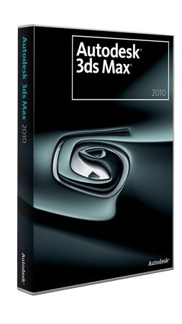




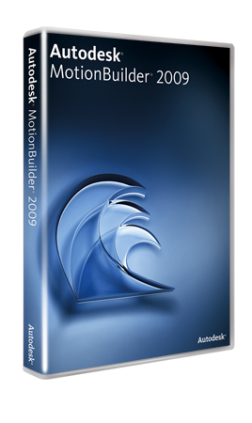

Slide 39


